Slide 1

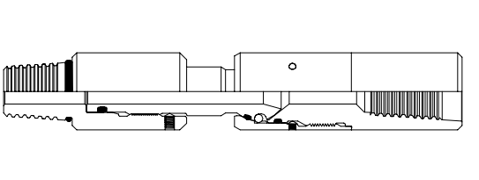
Thru-Tubing Fishing Single Knuckle Joint
Editor: Jalal Alali
2018.05

Slide 2
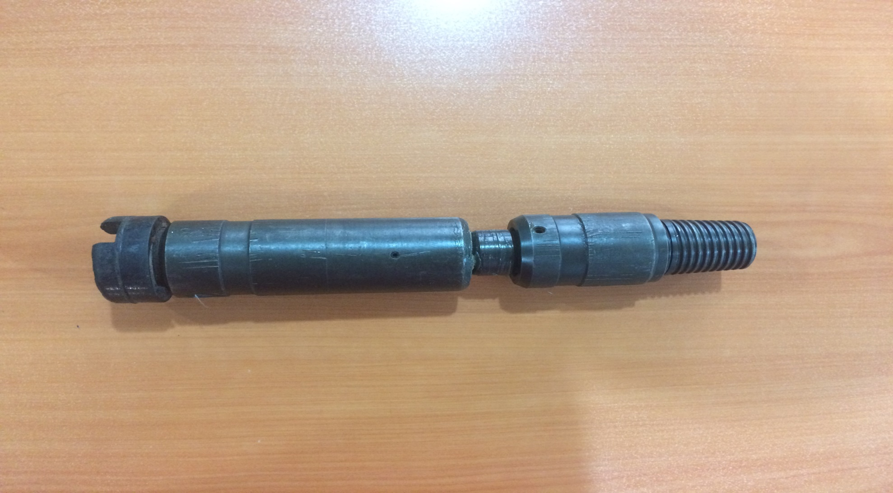

Slide 3
CONTENT
Introduction of Tool
Disassembly
Assembly

Slide 4
The Thru-Tubing Single and Double pivot Knuckle joint are used in fishing operations in deviated wellbores , or in any situation requiring centralization of the catch tool in the casing . The Knuckle joints are used in conjunction with a Thru-Tubing hydraulic or mechanical centralizer in order to allow centralization of the catch tool without having to overcome the weight of the work string against the bottom side of the casing . The hydraulic or mechanical centralizer therefore only has to support the weight of itself and the catch tool run below .
Introduction:

Slide 5
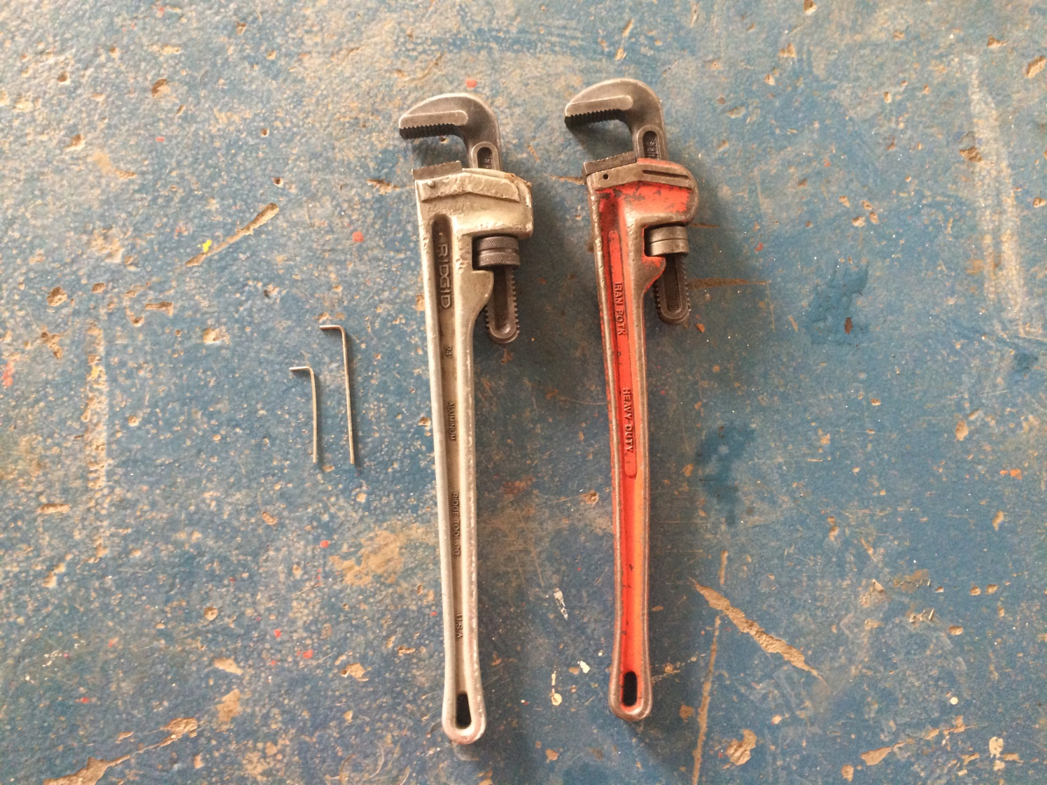
Required hand tools
Pipe Wrench
Allen key

Slide 6
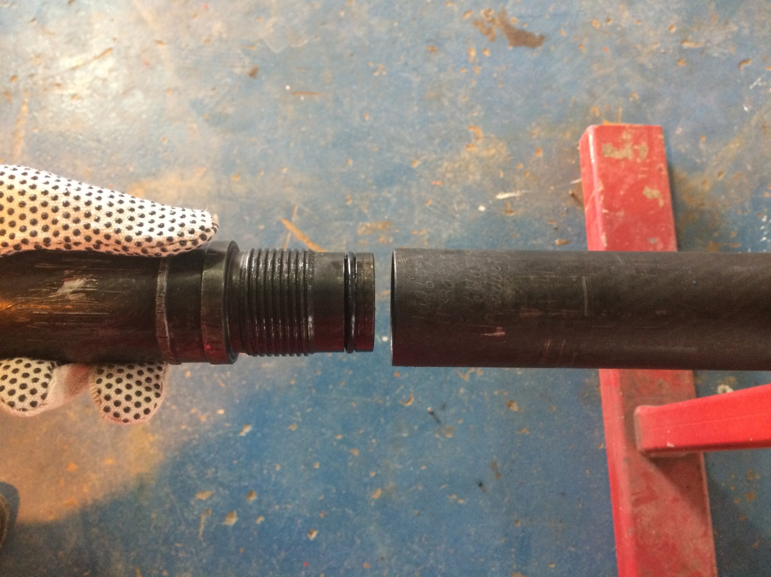
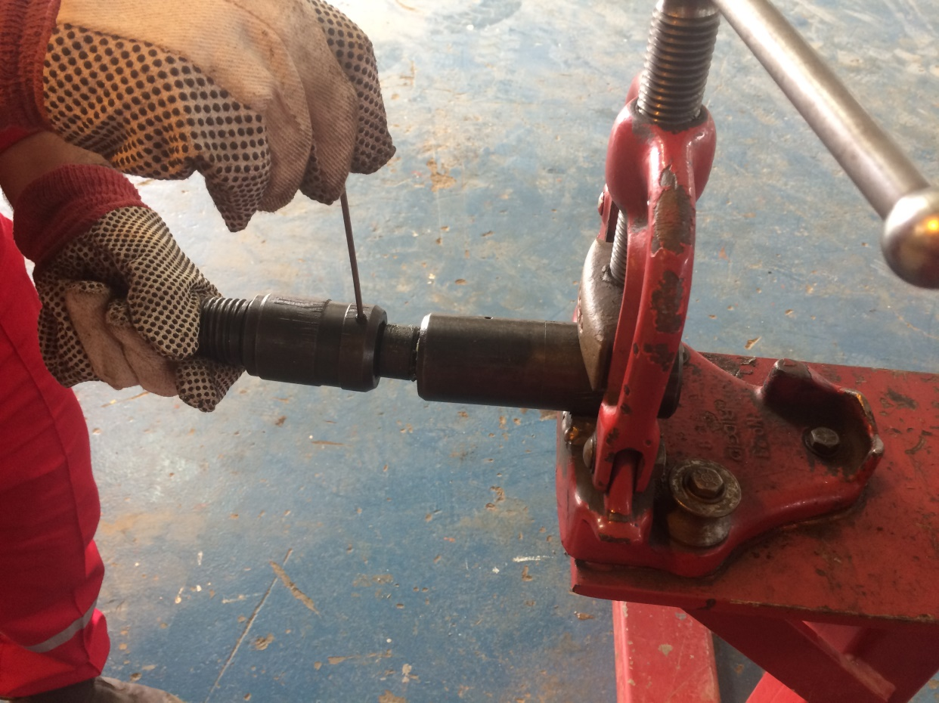
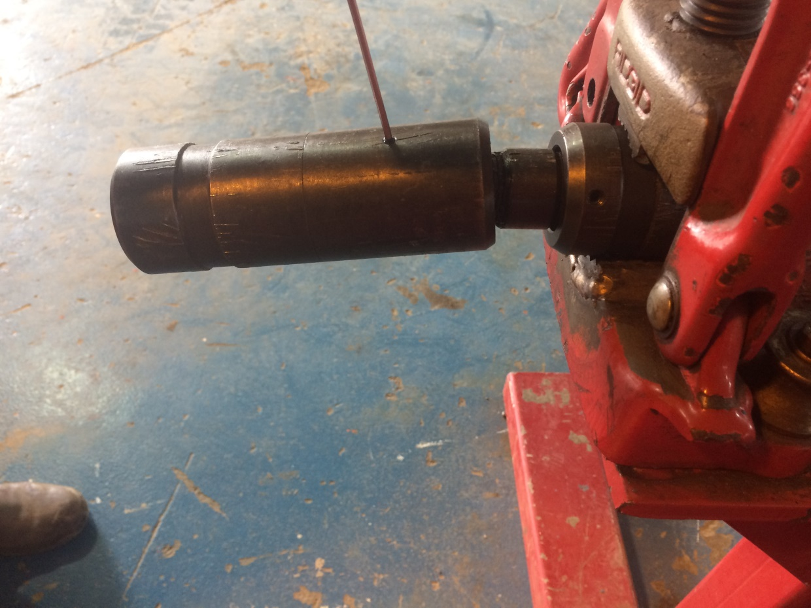
Disassembly
1- Remove the Set screws from the ball retainer and bottom sub .
A
B
Top sub
Bottom sub

Slide 7
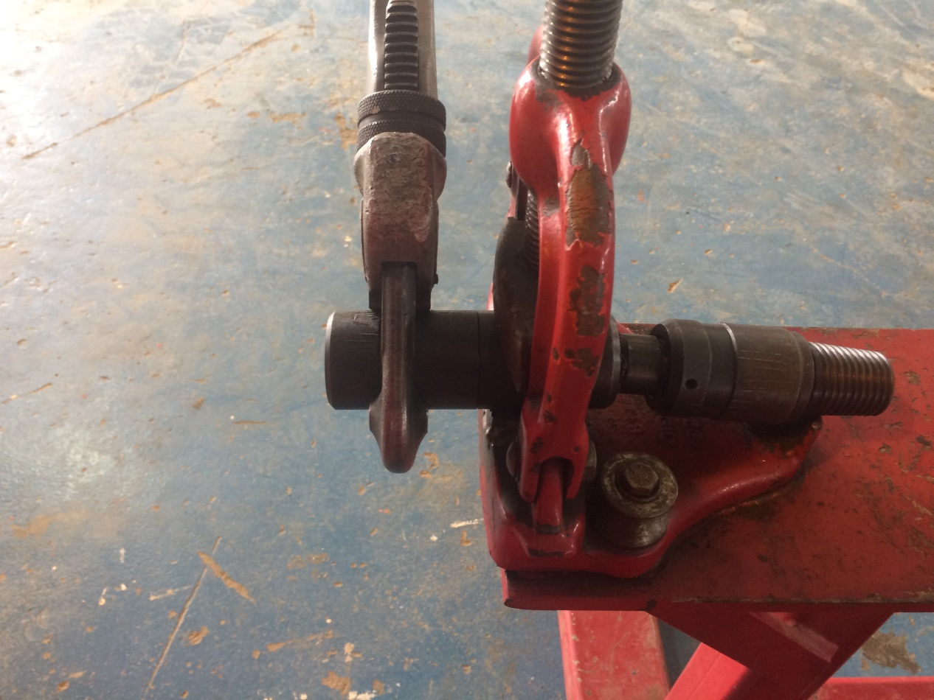
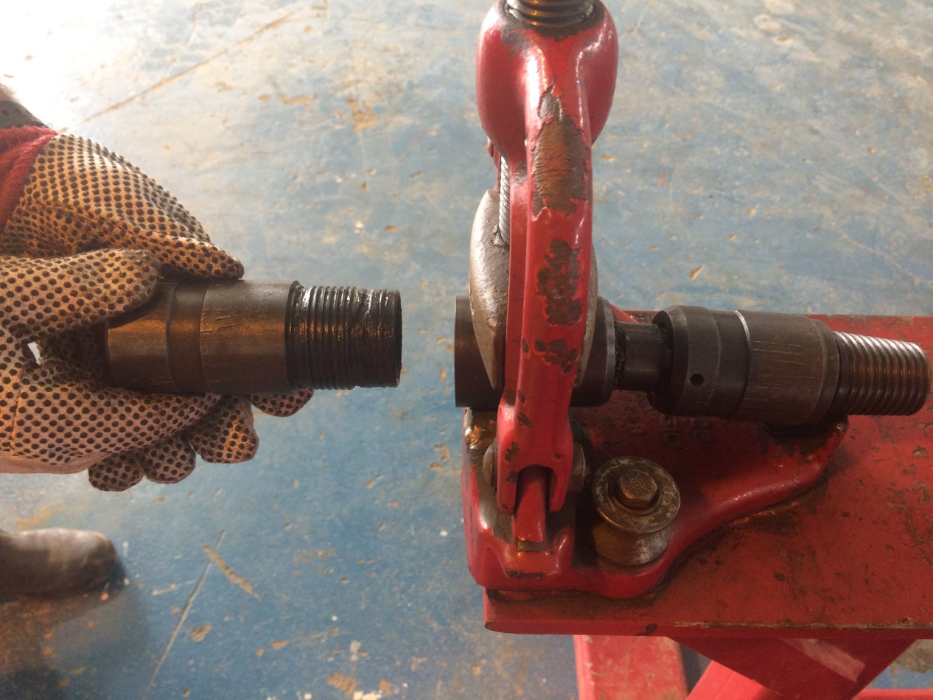
2-Unscrew the Ball retainer from the top sub .
A
Ball sub
B
Top sub
Ball retainer

Slide 8
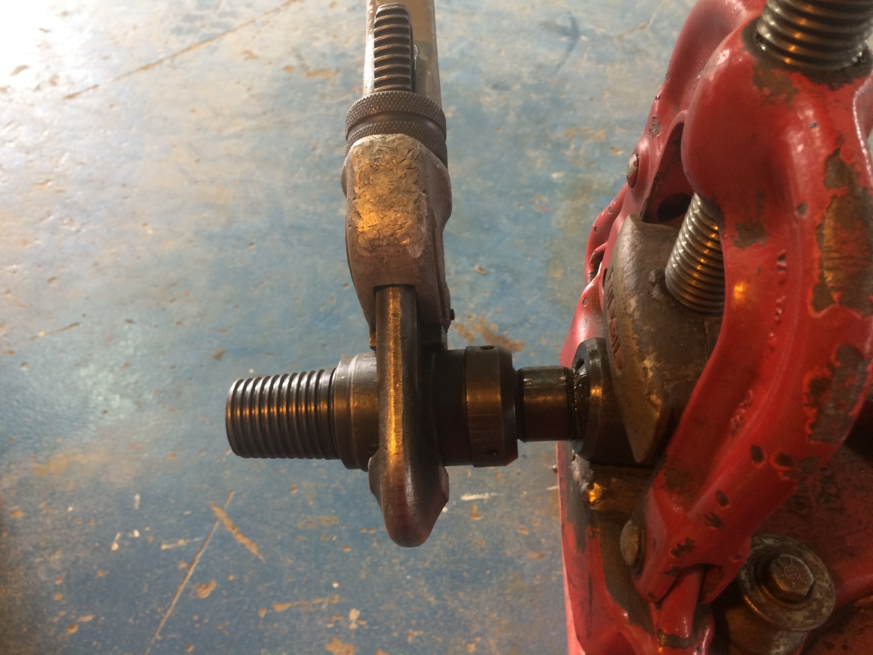
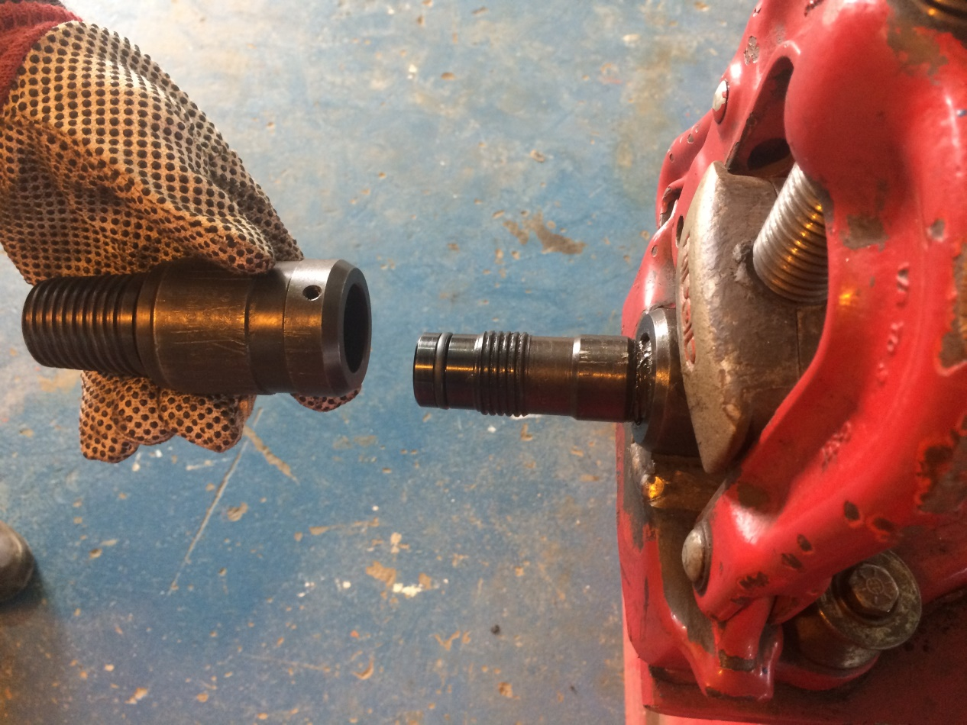
3- unscrew the ball sub from the bottom sub
A
B
Bottom sub
Bottom sub

Slide 9
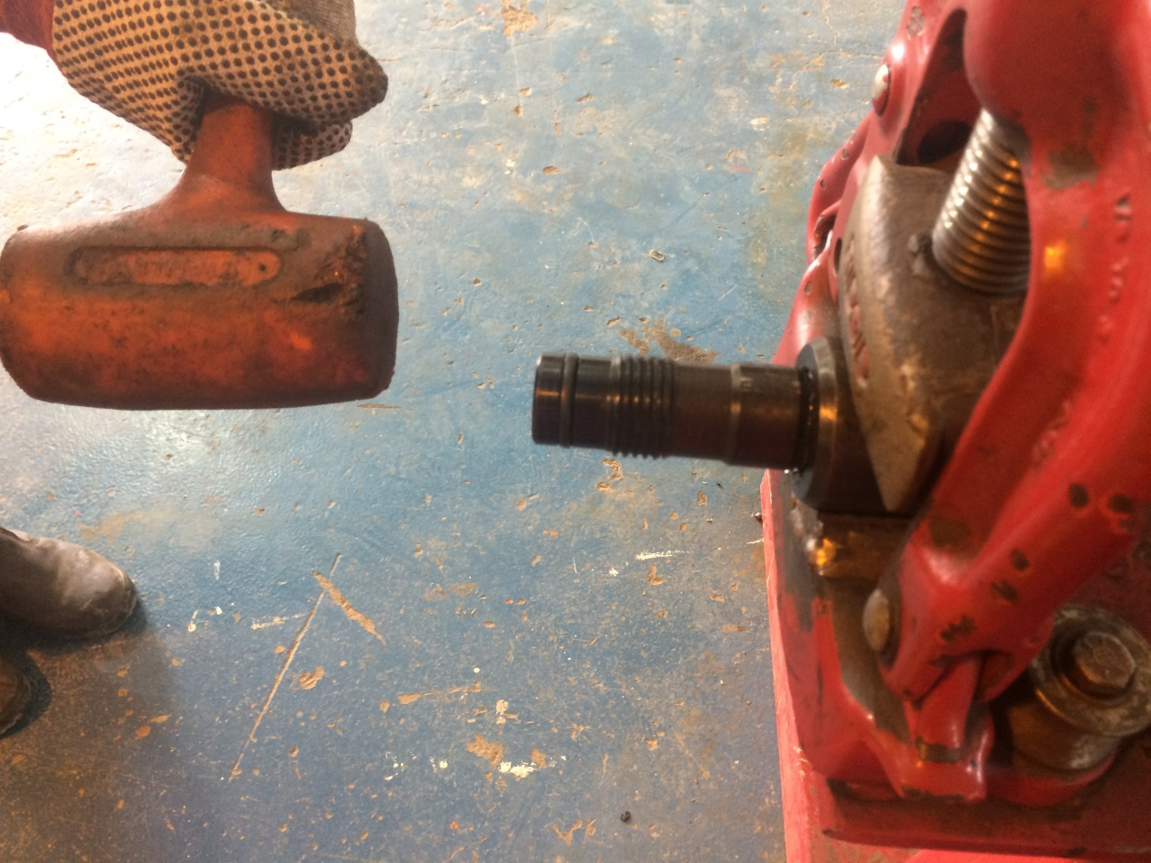
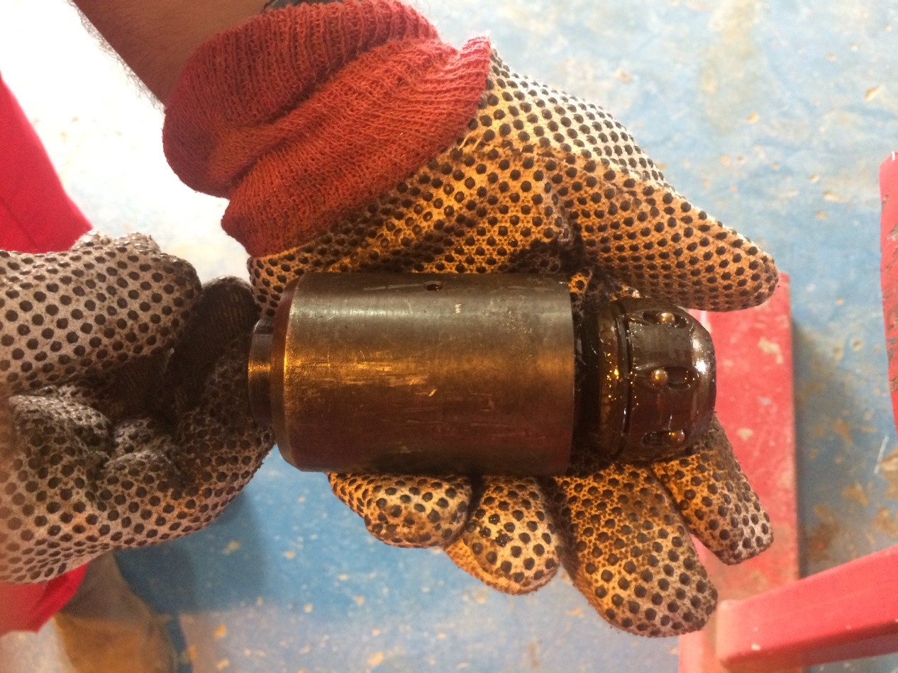
3- remove the ball subs from ball retainers. .
A
B
Ball retainer
Ball sub

Slide 10
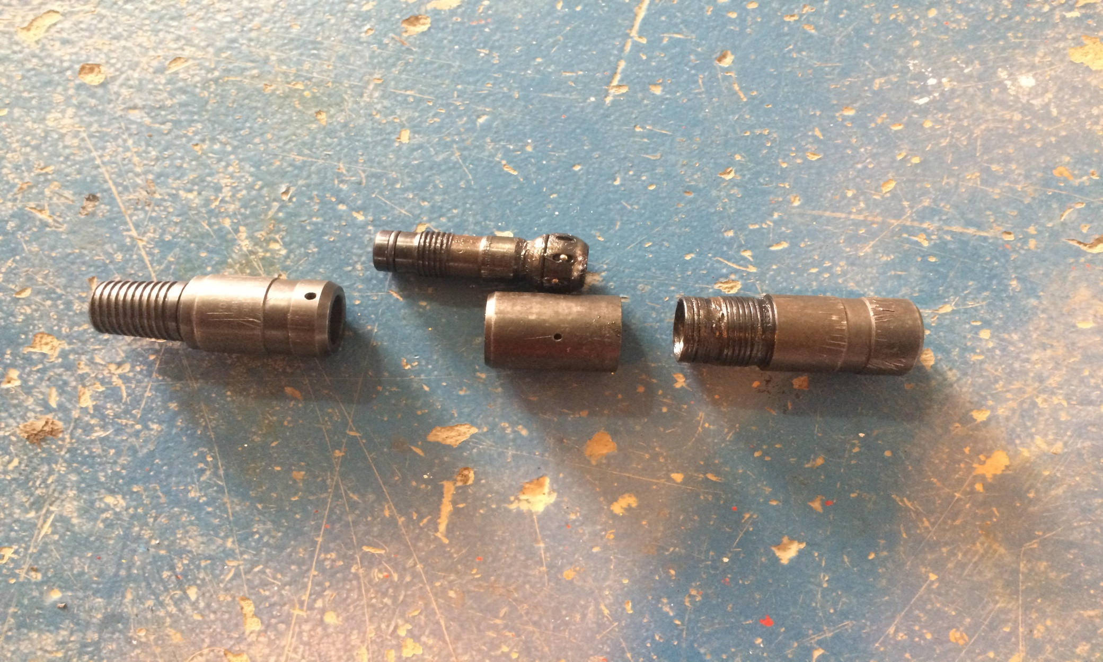
Ball sub
Bottom sub
Ball retainer
Top sub

Slide 11
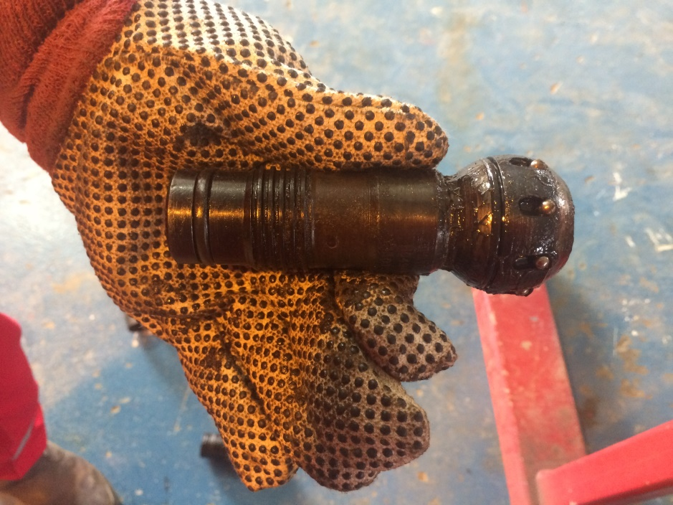
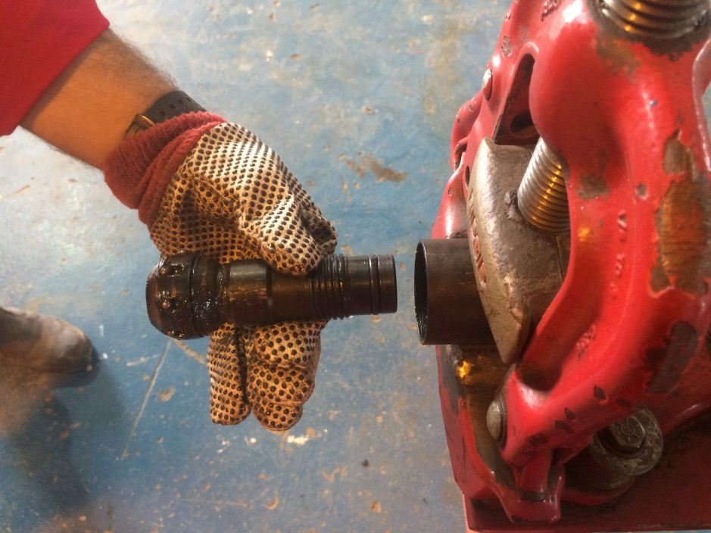
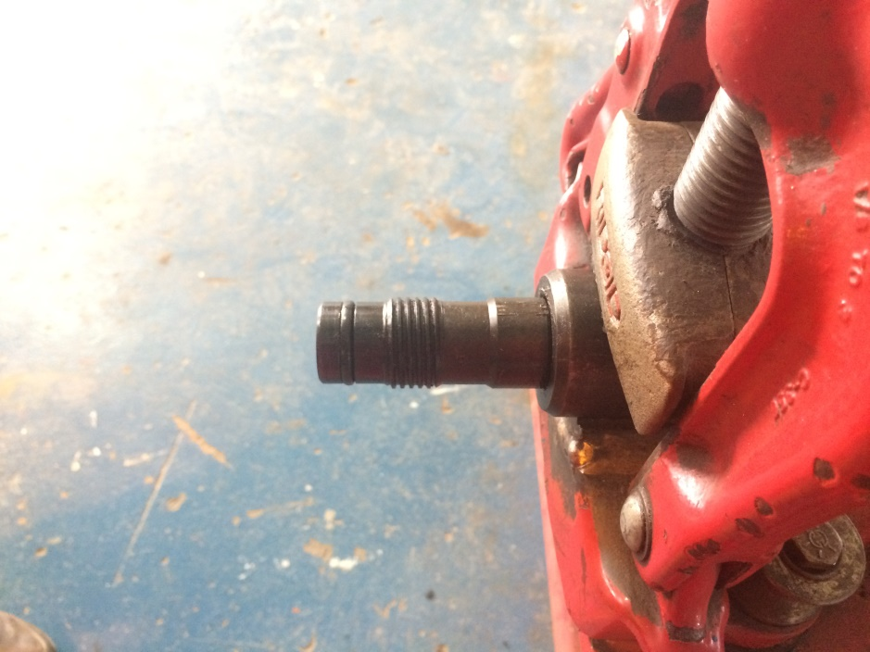
1- slide the ball sub into the ball retainer .
Assembly
A
B
C
Ball sub

Slide 12
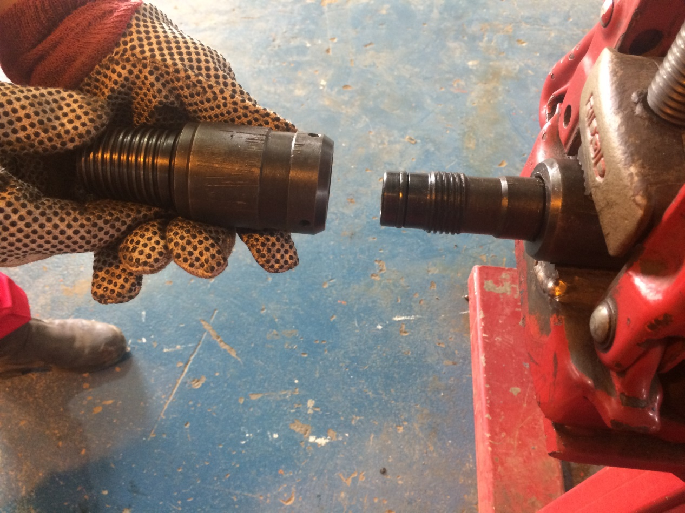
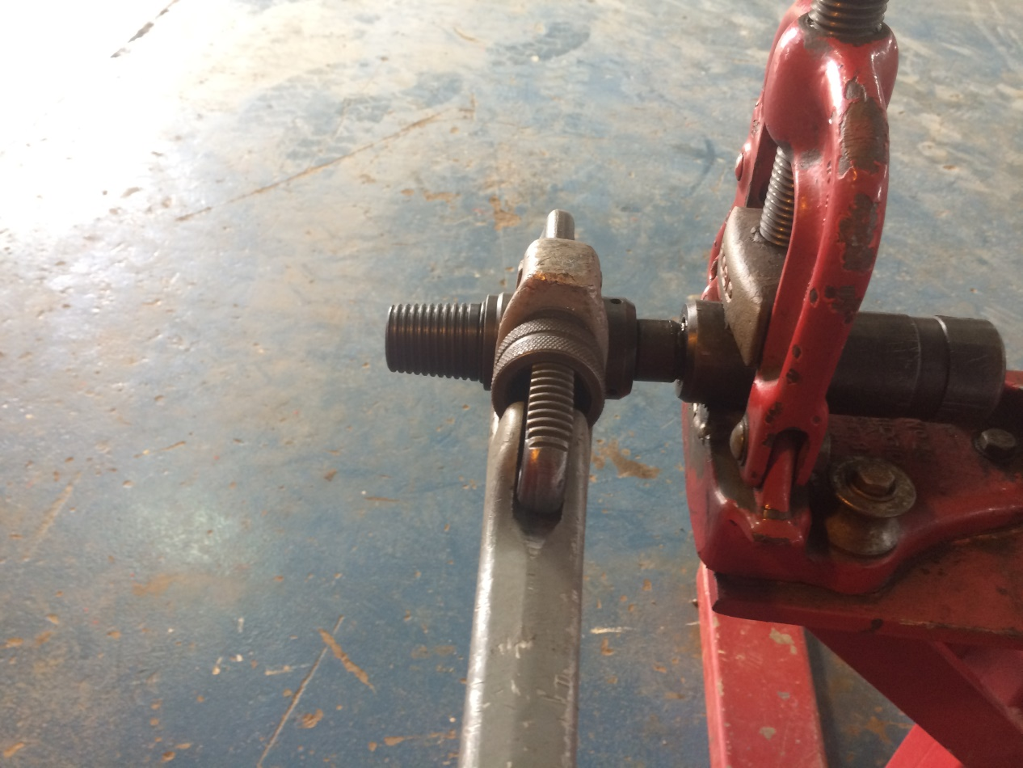
2- Make up the ball sub to the bottom sub .
A
Ball sub
B
Bottom sub

Slide 13
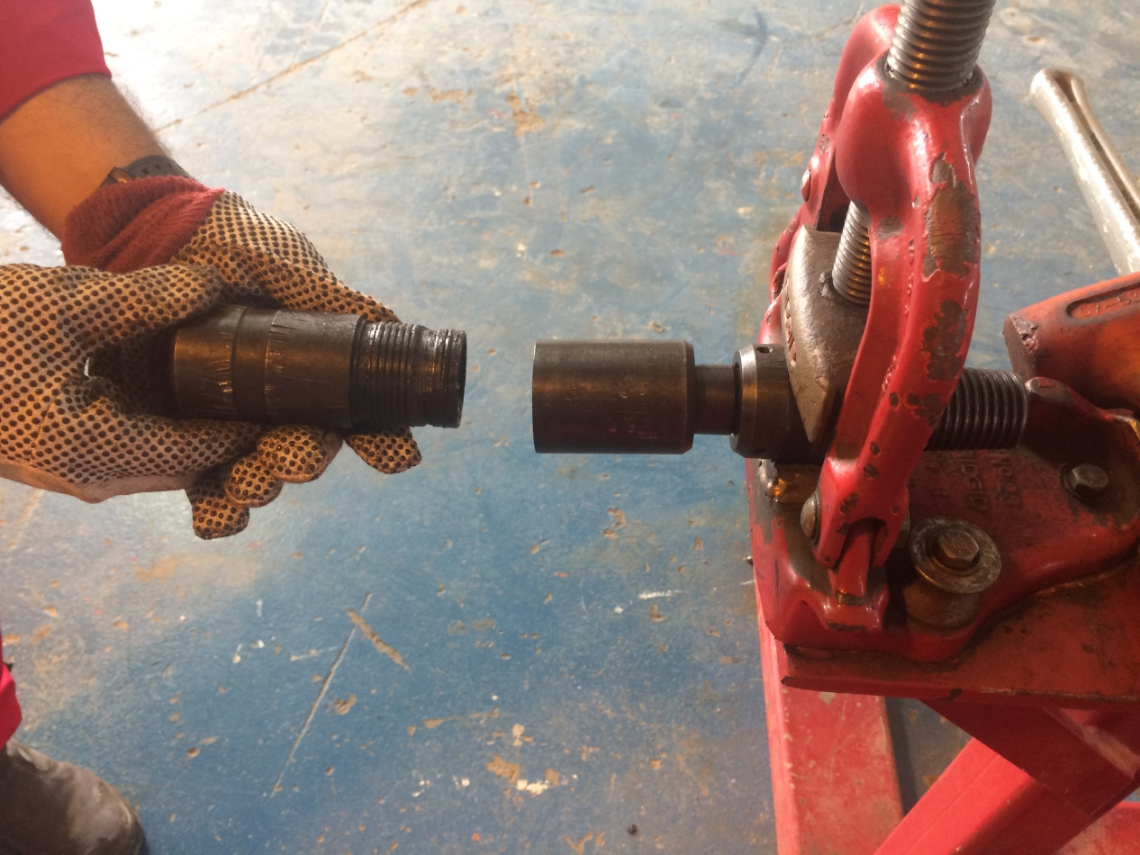
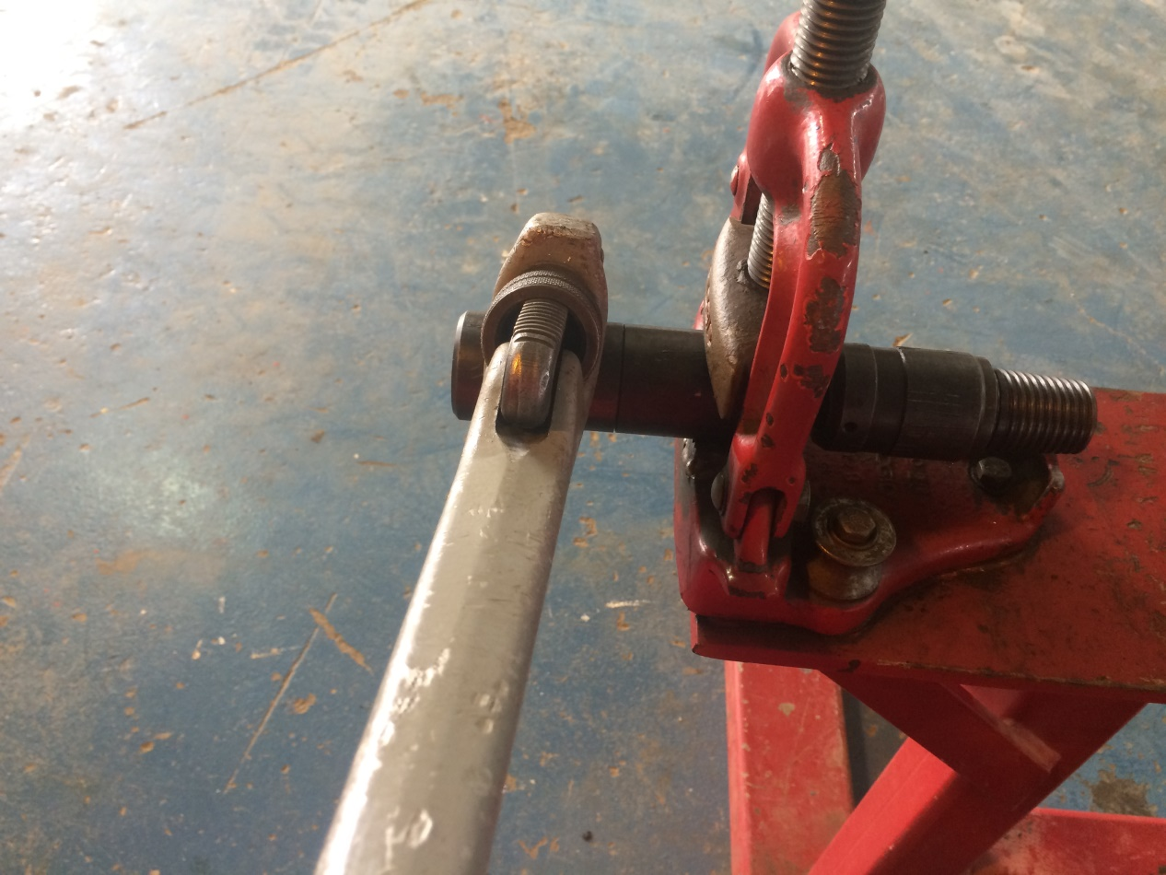
3- Make up the ball retainer to the top sub .
A
B

Slide 14
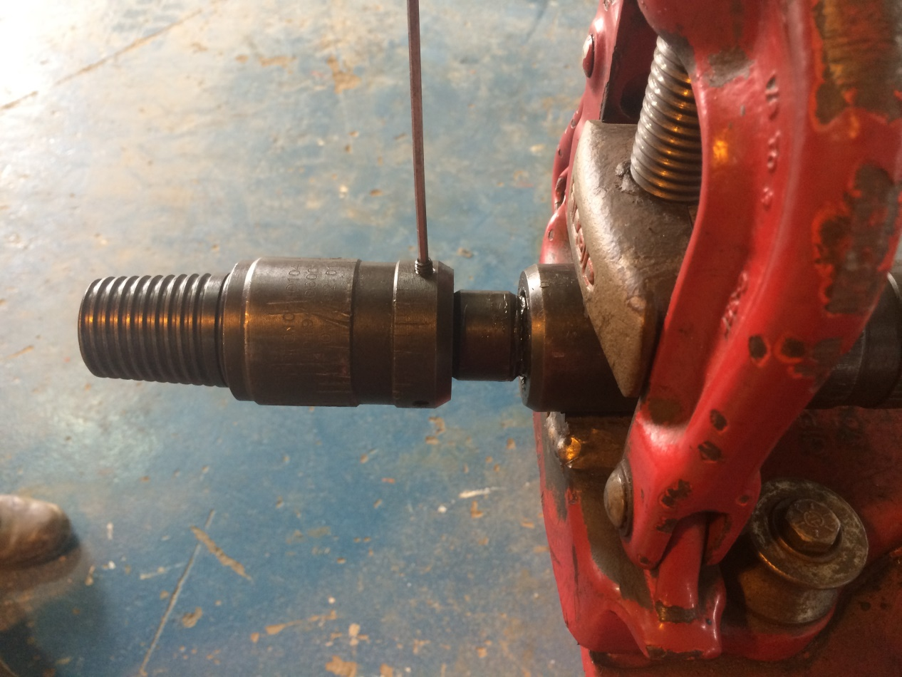

4- install the set screws into ball retainer and bottom sub .
A
B

Slide 15
Well Done!

